Slide 1
COUNTER XML Examples
File Management
2009-05-06

Slide 2
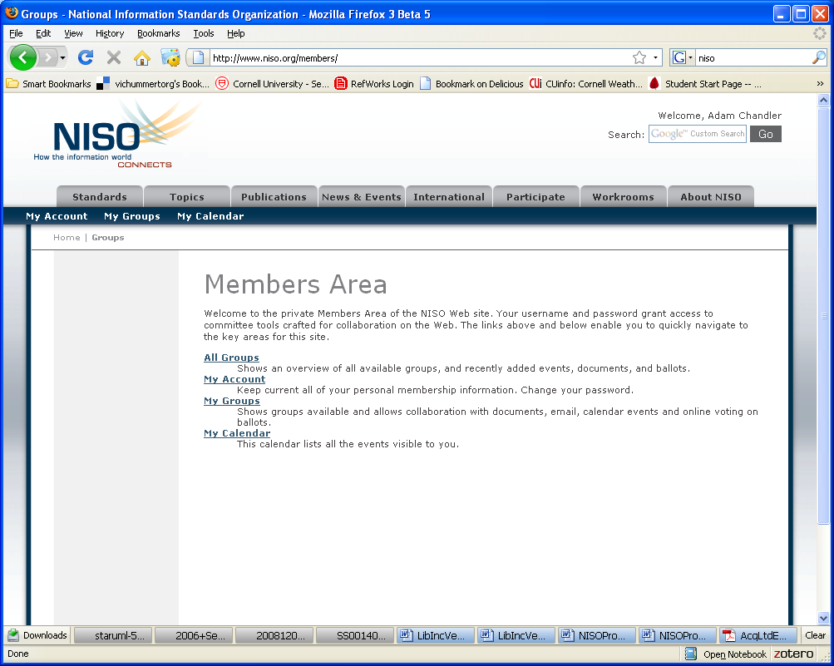
1. Log in kavi via: http://www.niso.org/home

Slide 3
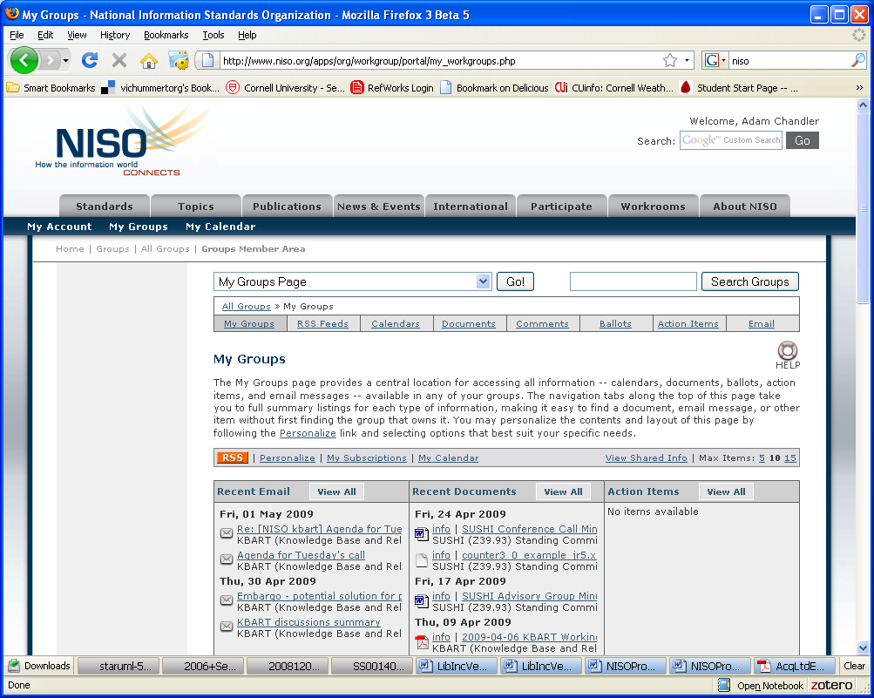
2. My Groups display

Slide 4
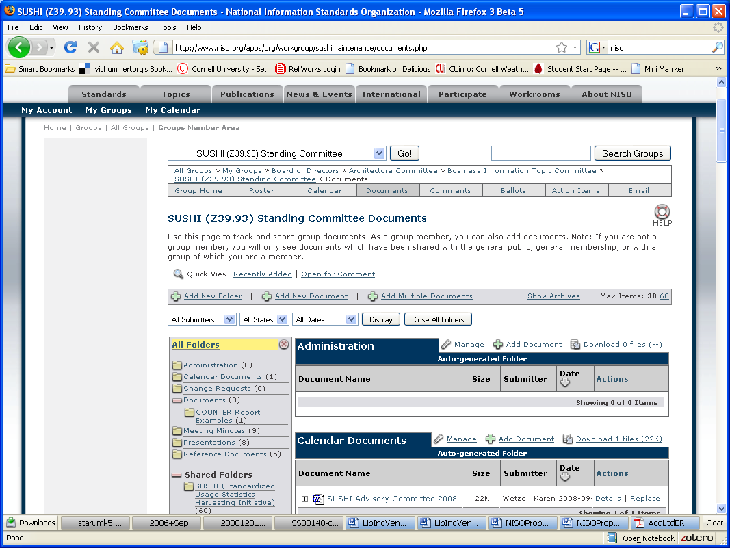
3. From the drop down menu, select SUSHI Standing Committee.
http://www.niso.org/apps/org/workgroup/sushimaintenance/documents.php

Slide 5
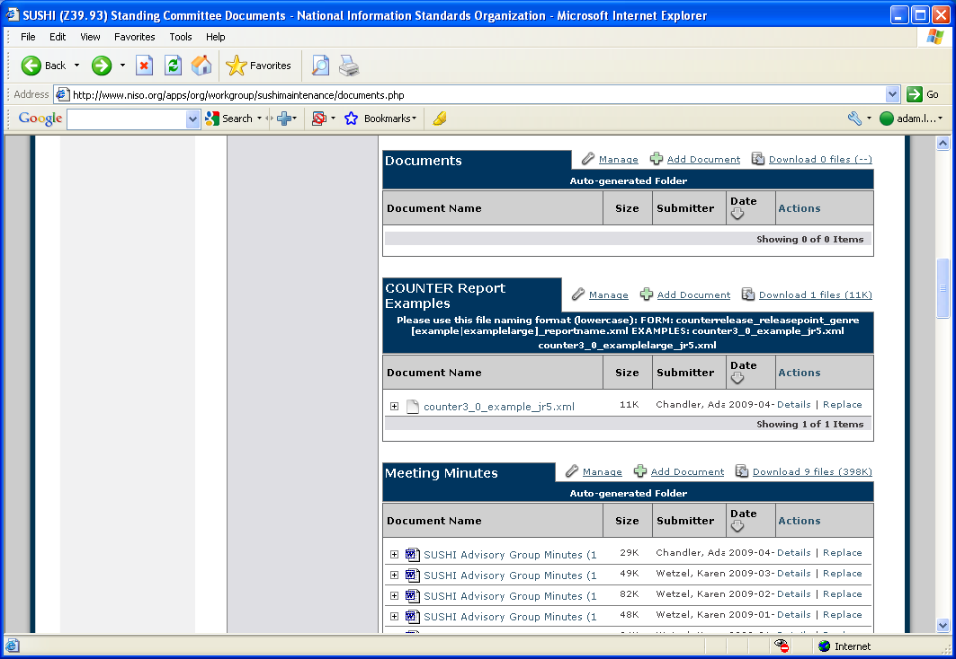
4. Scroll to the COUNTER Report Examples section:
http://www.niso.org/apps/org/workgroup/sushimaintenance/documents.php

Slide 6
File Naming Convention:
FORM:
counterrelease_releasepoint_genre[example|examplelarge]_reportname.xml
EXAMPLES:
counter3_0_example_jr5.xml
counter3_0_examplelarge_jr5.xml

Slide 7
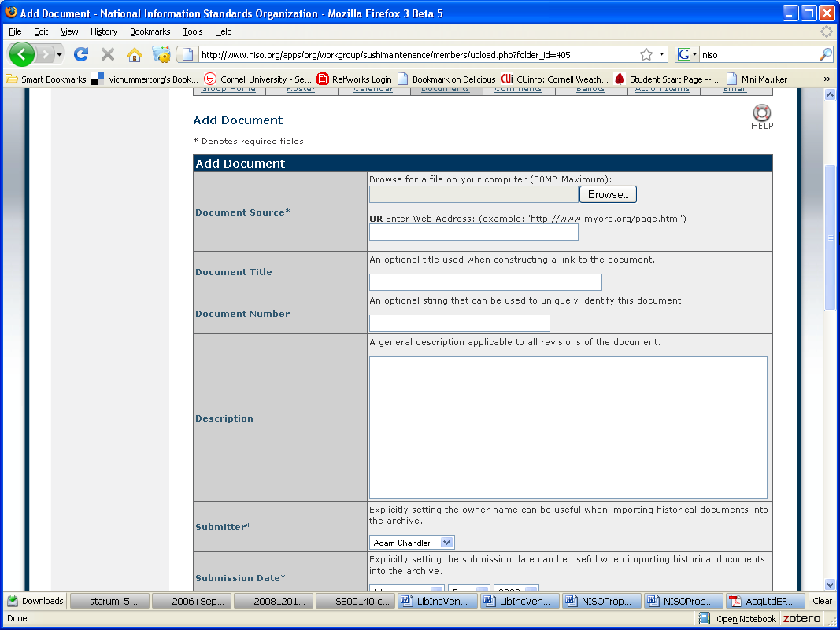
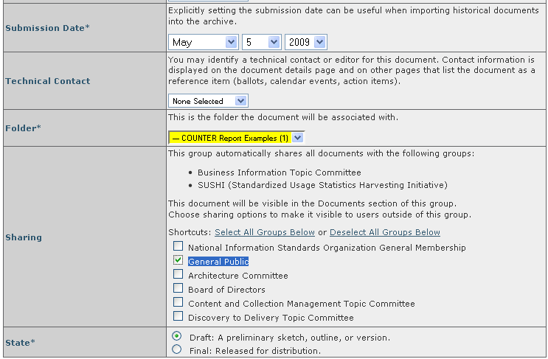
5. Upload document.
check the “General Public” sharing option.
check “Draft” as the State (after the document passes review we will change the state for Final).

Slide 8
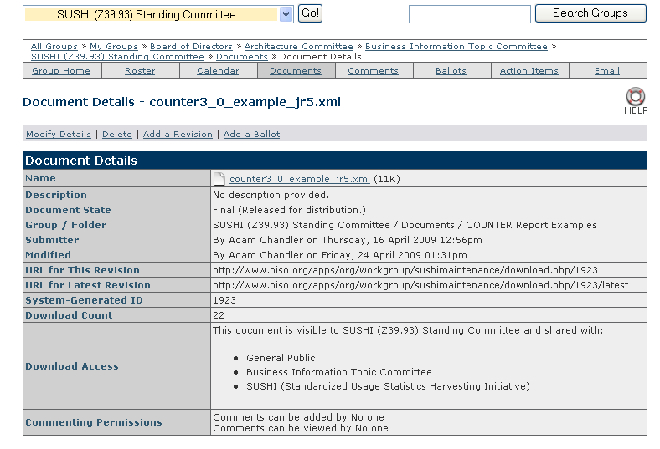
This is a screenshot of the detail record. Note that it is possible to replace it with a revision.

Slide 9
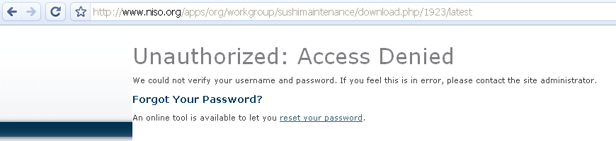
WARNING!
The URLs in the detailed description work for kavi users, but DO NOT work for the public. This apparently is a bug.
use this URL form instead to share with public:
http://www.niso.org/apps/group_public/document.php?document_id=1923&wg_abbrev=sushimaintenance

Slide 10
"sushidevelopers" <sushidevelopers@list.niso.org>
6. Solicit comments from the SUSHI community using the SUSHI developers’ list serv. If changes need to be made, go back to step 5.

Slide 11
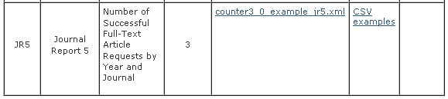
http://www.niso.org/workrooms/sushi/reports
7. When the comment period is completed create a link to the final file version stored on kavi from the Reports page on the SUSHI website. Note that the “CSV” example link is to the COUNTER COP, Appendix F.

