Slide 1


2024 Membership Meeting
NISO Annual Report of 2023 Activities
NISO Annual Meeting Webinar
June 25, 2024

Slide 2
2023 Membership Meeting Overview
NISO’s Vision, Mission and Strategic Priorities
2023/24 Reflections
NISO 2023 Membership – Mary Beth Barilla
NISO 2023 Education & DEIA Initiatives – Kimberly Graham
NISO Standards Program – Nettie Lagace
NISO Plus – Jason Griffey
NISO 2023 Finances
Looking Forward 2024-26
Open discussion of NISO activities

Slide 3
NISO acknowledges that
the land on which our office sits in Baltimore is rooted in the unceded, traditional territories of the Piscataway, Susquehannock, and Nanticoke peoples, as well as being the contemporary home to a living community of Lumbee people.
For more information, please visit: https://native-land.ca

Slide 4
NISO’S VISION

Slide 5
NISO’s vision is a world where all benefit from the unfettered exchange of information

Slide 6
NISO’S MISSION

Slide 7
The mission of NISO is to build knowledge, foster discussion, and advance authoritative standards development through collaboration among the cultural, scholarly, scientific, and professional communities.

Slide 8
NISO’S VALUES

Slide 9
NISO seeks consensus among participants in our work and strives for outputs that serve a worldwide community.
NISO is committed to diversity, equity, inclusion, and accessibility in everything we do.
NISO equally values the contributions of all voices in our processes.

Slide 10
NISO’S NEW
STRATEGIC PLAN

Slide 11
Growth
Community
Leadership
Standards Development
Diversity
Notes:
1) Establish the NISO Plus Conference as an influential and impactful forum for thought leadership and discussion, which fosters collaboration and innovation
2)Identify emerging trends and create forums (physical or virtual) that help anticipate future needs and directions, in order to drive actionable and valuable outputs
3) Maintain and develop relevant activities in support of advanced information management services, particularly in the humanities community and in government organizations

Slide 12
Adopting a New Strategy
Growth
Community
Leadership
Throughout 2023 a subcommittee of the Board met to discussion a revised strategic direction document.
In October 2023, the NISO Board adopted a new Strategic Plan.
NISO is committed to diversity and providing high-quality guidance (standards/best practices) for the community.
In service of these two outcomes, we seek to build a stronger community, that provides leadership and thoughtful support, while seeking to grow strategically to enhance our capacity and sustainability.
Standards Development
Diversity

Slide 13

More Efficient With Standards
Notes:
1) This is why we exist as an organization. It is our core mission and the driving force behind all we seek to achieve. We connect communities to solve their problems, improve their business processes and help them better serve their customers and communities.

Slide 14

Diversity, Equity,
Inclusion & Accessibility
Notes:
Infused in everything we do. Diversity helps us to improve our outcomes because we seek to engage diverse voices and perspectives in our work. We aim to engage people not simply because it is the right thing to do, but because it improves the outcomes we aim to seek. Engagement, involvement and meaningful participation drives more successful outcomes.

Slide 15

Community Development
Notes:
Build a strong and engaged community to drive membership and ensure sustainability through increased financial support
Build community awareness and understanding of NISO standards and their value in order to drive adoption and implementation
Optimize training and resources that address information management trends to most effectively educate and engage members and the wider community
Continue to engage meaningfully with organizations that were part of the NFAIS community

Slide 16
NISO Strategic Plan: Community
NISO nurtures an engaged, inclusive, and sustainable community. NISO is recognized for connecting diverse stakeholders and inspiring collaboration among them.
Strategic Priorities 2023-2026
NISO provides its members and community resources and information they value so that they can understand developments and trends in our communities.
NISO is a welcoming environment for people of all backgrounds and perspectives and encourages an inclusive perspective and participation in our programs, our technical development work, and leadership.
Members and the wider community use NISO’s education, training, and management resources to engage on critical information management issues.
Members of underserved/marginalized communities and early career professionals have access to industry information, development and volunteer opportunities, and mentors that will support their increased involvement in NISO’s efforts and their overall career success within our stakeholder community.

Slide 17

Effective Thought Leadership
Notes:
1) Establish the NISO Plus Conference as an influential and impactful forum for thought leadership and discussion, which fosters collaboration and innovation
2)Identify emerging trends and create forums (physical or virtual) that help anticipate future needs and directions, in order to drive actionable and valuable outputs
3) Maintain and develop relevant activities in support of advanced information management services, particularly in the humanities community and in government organizations

Slide 18
NISO Strategic Plan: Leadership
NISO builds knowledge through leadership and innovation in improving efficiency in our community. NISO is recognized for its expertise and considered an exemplar for standards development for information management.
Strategic Priorities 2023-2026
Advance community best practice through a focus on the value that standards bring to organizations and people engaged in content creation, dissemination, preservation and use.
Provide leadership and support innovation to improve efficiency as content forms and information management models change. Continue to translate that leadership into action and outputs that improve community practice and efficiency.
Continue to build upon the NISO Plus Conference as an influential and impactful forum for thought leadership and discussion, which fosters collaboration and innovation. Seek to build the NISO Plus branded events portfolio through virtual and in-person events.
Using the NISO Plus model and its outputs, identify emerging trends affecting cultural, scholarly, scientific, and professional communities and create forums to foster discussion and build knowledge to ensure members and the community have the information/understanding to address these emerging trends.

Slide 19

Growth
Notes:
1) Establish the NISO Plus Conference as an influential and impactful forum for thought leadership and discussion, which fosters collaboration and innovation
2)Identify emerging trends and create forums (physical or virtual) that help anticipate future needs and directions, in order to drive actionable and valuable outputs
3) Maintain and develop relevant activities in support of advanced information management services, particularly in the humanities community and in government organizations

Slide 20
NISO Strategic Plan: Growth
NISO grows meaningfully and expands its standards work and services portfolio in areas of highest demand and the greatest potential for expanding our resources. NISO is recognised for actively seeking new opportunities.
Strategic Priorities 2023-2026
Continue to ensure NISO’s sustainability and increased financial support from existing stakeholder groups through a focus on value and quality service.
Explore areas where NISO can strategically extend its involvement in adjacent domains or communities and develop programs, services or leadership opportunities where NISO can add the greatest value.
Articulate and communicate clearly NISO’s value proposition to existing and targeted potential stakeholders for actions in new domains.
Using the NISO Plus structure and NISO’s Leadership activities, extend NISO’s standards work into new domains which are nascent or developing to support innovation in our community.

Slide 21
Executing This Strategy
Growth
Community
Leadership
Beginning in 2024, we began a series of announcements and outreach to communicate these plans to the membership.
Each of the items above is being tracked by the NISO Staff and the Board of Directors.
The Board has identified several KPIs related to the priorities noted previously and we will be reporting regularly on our progress.
If necessary, adjustments can be made as NISO’s priorities change over time in response to market conditions.
Standards Development
Diversity

Slide 22
Reflections on 2023-24

Slide 23

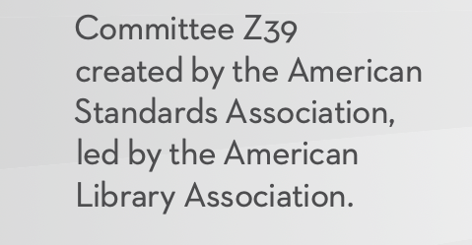
June 22, 1939

Slide 24
2023-24 Serving our community
NISO now has 38 active working groups, subgroups, and maintenance committees
  By comparison, in 2009, NISO had 13 active projects
NISO hosted 47 virtual events, two in-person events, and the NISO Plus Virtual Conference, or an average more than 4 per month
  By comparison in 2009, NISO hosted 13 virtual events and 3 in-person
NISO membership is now more than 1,000 organizations
  By comparison in 2009, NISO had 109 members
NISO Plus 23 events drew more than 700 participants online and in-person

Slide 25

Consensus isn’t always easy

Slide 26
NISO Standards Development Work in 2023
3
Newly Published RP or Standards
2
Drafts for public comment issued
4
New Projects/Groups Launched
1
New Grant of $49,000 to support NISO Plus Scholarships
Notes:
One fewer publication. 1 fewer grants. 8 projects down from 4 (but CCLP is really more than 1).

Slide 27
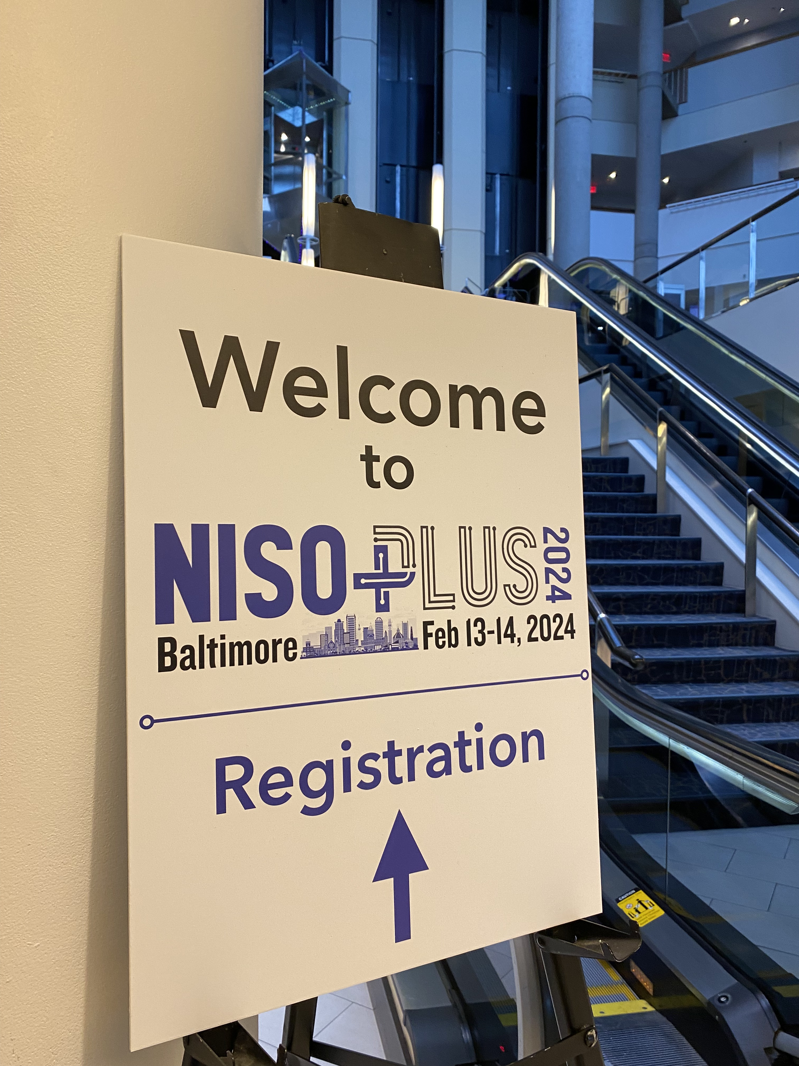
NISO PLUS

Slide 28
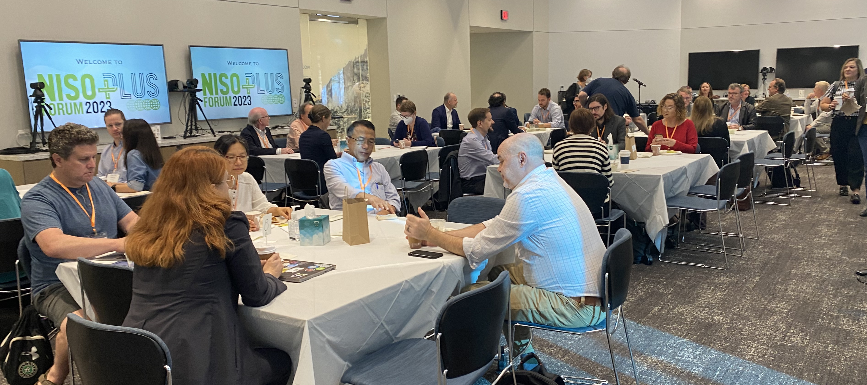

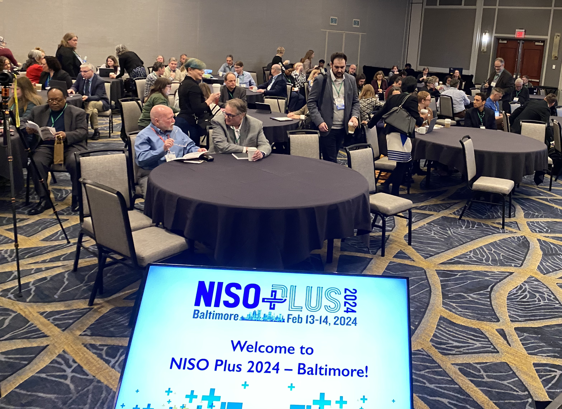


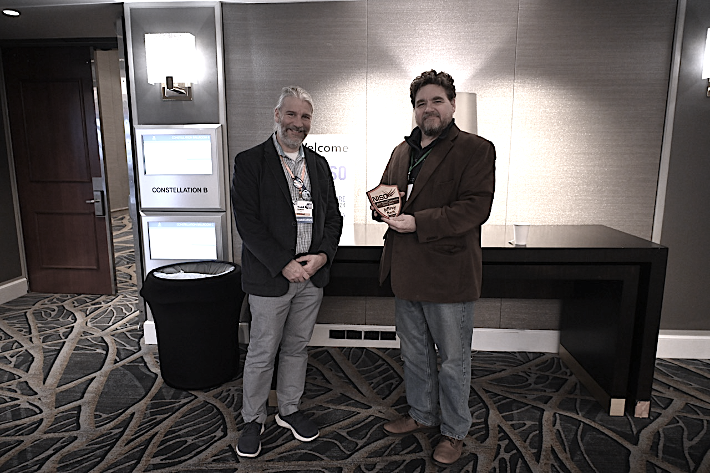

Slide 29

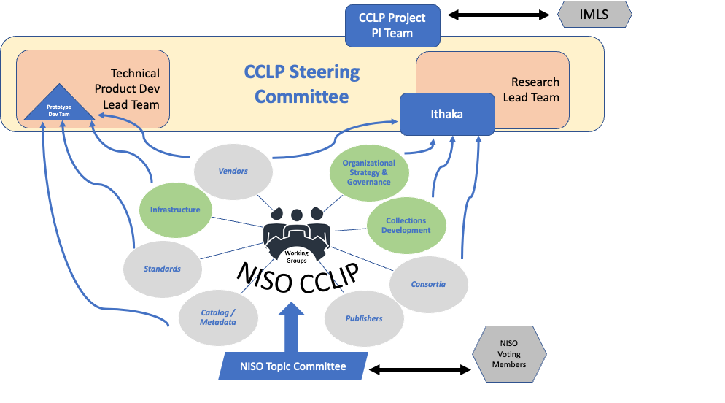



Seeking to improve library collaborative collections efforts with IMLS support
The CCLP project was made possible in part by the Institute of Museum and Library Services (IMLS)
Grant #: LG-252384-OLS-22. For more information about this grant: https://www.imls.gov/grants/awarded/lg-252384-ols-22

Slide 30

It’s a big world! NISO’s working within ISO

Slide 31
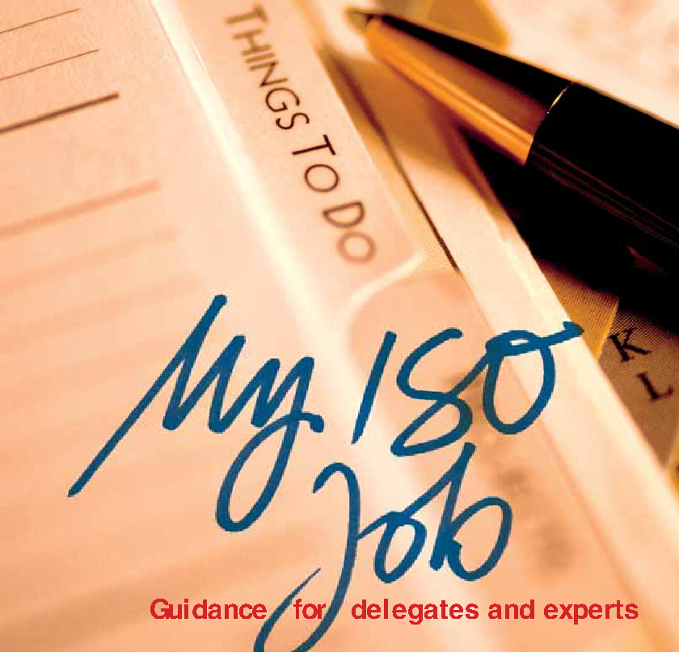
NISO’s Role in ISO, representing US interests
NISO is the US Technical Advisory Group determining US positions on ISO work in:
ISO TC 46 Information and Documentation
Technical interoperability (SC 4)
Statistics and performance evaluation (SC 8)
Identification and description (SC 9)
Document storage and preservation (SC 10)
Archives/records management (SC 11)
ISO JTC 1/SC34 Information Technology - Document description and processing languages

Slide 32
NISO Supports International Standards Development
NISO Serves as Secretariat for ISO TC 46/SC 9 Identification & Description
In January 2024, Todd Carpenter was elected Chair of TC 46/SC 9 and Keondra Bailey assumed the role of Committee Manager
NISO staff and its members participated in 7 ISO plenary meetings, and engage on 25 ISO working groups, and more than 35 projects.

Slide 33
ISO International Standards Work Published
ISO TC 46 published in 2023/24:
ISO 24138 – International Standard Content Code (ISCC)
ISO 23527 – Research activity identifier (RAiD)
ISO 21127 – Reference ontology for the interchange of cultural heritage
information (CDOC-CRM)
ISO 28560-1/3 – RFID in Libraries
ISO 11620 – Library performance indicators
ISO 11789 – Permanence and durability of writing, printing and copying
on paper
ISO 16245 – Boxes, file covers and other enclosures, made from
cellulosic materials, for storage of paper and parchment documents
TR 8344 – Issues and considerations for managing records in
structured data environments
ISO/IEC JTC 1/SC 34 published: ISO /IEC 23078- Parts1-3 — Specification of digital rights management (DRM) technology for digital publications

Slide 34
ISO International Standards Development Work
ISO TC 46 has begun work to revise/develop:
ISO 25964-1, Thesauri and interoperability with other vocabularies
ISO 999/5963 Guidelines for the content, organization and
presentation of indexes
ISO 26324 – Digital object identifier system
ISO/DIS 16687 – Impact assessment for museums
ISO DTR 24332 – Blockchain and Distributed Ledger Technology in relation to authoritative records, records systems, and records management
ISO/AWI 30301 – Management systems for records — Requirements
ISO/IEC JTC 1/SC 34 working on revision of ISO/IEC 29500 Office Open XML

Slide 35
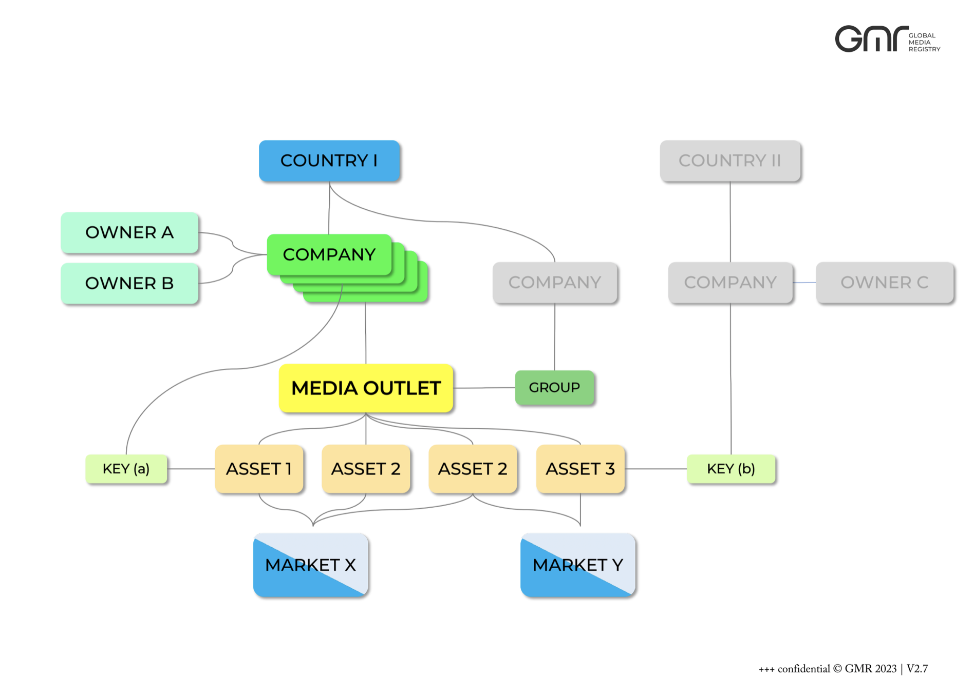
ISO IWA
Unique Media Identification
How to Identify Media Outlets
ONE Example of how media companies are organized
UMiD

Slide 36
New ISO Technical Committee
ISO TC 349 – Cultural Heritage Conservation
Proposed by the Chinese National Standards Administration (SAC) and approved by the ISO Technical Management Board in February.
Scope:
Standardization in the field of terminology, technologies, materials and equipment for monitoring, evaluation, preservation and restoration of cultural heritage.
Excluding: ISO/TC 36 Cinematography, ISO/TC 42 Photography, ISO/TC 46 Information and documentation
NISO has applied to assume the role of representation US interests as the Technical Advisory Group

Slide 37

Membership Report

Slide 38
Positive Membership Trends
Four new NISO Voting Members in 2023/24
  Boston Library Consortium
  J. Paul Getty Trust
  Scholastica
  Synaptica
  Six Non-Renewals of NISO Voting Members
Notes:
Innovative, Getty and eLife were non-renewals

Slide 39
Positive Membership Trends
Five new LSA Members
  Dominican University of California
  Elon University
  RAND
  University of California, Davis
  University of Minnesota
  Two Non-Renewals of NISO LSA Members
  Boston Library Consortium added 18 new LSA members as a group
  5 new libraries joined through the Canadian Research Knowledge Network Consortium
Notes:
No non-renewals of LSA

Slide 40
Positive Membership Trends
One new Individual/Sole Proprietor Member
    Sheeba Medterm, Inc.
Notes:
No non-renewals of LSA

Slide 41
Education Report

Slide 42
Education & DEIA
NISO Staff Member: Kimberly Gladfelter Graham,
Education Program Manager & DEIA Advocate
Notes:
I’m KGG, my pronouns are she/her. I am NISO’s Education Program Manager and DEIA Advocate. As part of that, I work with our amazing Education and DEIA Committees, and I have the added responsibility and privilege of managing the NISO Plus Scholarship Program.

Slide 43
Diversity
Equity
Inclusion
Accessibility
In 2023, the Board of Directors took the decision to pause the committee and conduct an assessment.
The conclusion was to reset the committee and its charges.
New Charges and Deliverables
Establishment of a new committee
New committee is working to bring those deliverables into focus and fruition
Notes:
Despite the order of the roles in my title, I’m going to begin with DEIA. I’m going to do so because we, the NISO staff, board, and our committees, are all working to ensure that diversity, equity, inclusion, and accessibility are priorities woven into the fabric of what we do and how we do so.
The DEIA Committee is under the direct responsibility and oversight of the of Board of Directors. In 2023, the BOD decided to pause the existing committee and conduct an effectiveness assessment. The conclusion was to reset the committee and re-write the charges with clear and effective goals and deliverables. We thanked members of the established committee for their time and commitment, and the committee was dissolved. A new committee was formed and we are pleased to welcome…

Slide 44
DEIA Committee Members
Trevor Dawes (BOD)
Yali Feng
Judith Fraenkel, Current Chair
Ruth Haber
Yuimi Hlasten, ’22
Salwa Ismail (BOD), Past Chair
Rosy Salman Khan ’23
George Kerscher
Sandra Kiselica
Preeti Gokal Kochar
Rebecca McLeod (BOD)
Russell Michalak ‘22
Johanssen Obanda, ’21
Christie Peters
Deborah Poff
Merrilee Proffitt
Anjaneya Reddy ‘22
Ellen Riney
Cassidy Sugimoto
Maria Stanton, Founder and Honorary Member (BOD)

Slide 45
Thank you
Notes:
We would like to extend our sincere gratitude to Salwa Ismail for her leadership, steering the DEIA Committee through this evolution. We would also like to welcome and thank Judith Fraenkel for picking up the baton, and everyonee who has served on the NISO DEIA Committee past and present.
As stated on the NISO website: By advocating for and promoting diversity, equity, inclusion, and accessibility, the DEIA committee strives to be a catalyst for positive change and growth within the NISO organization, its work, output, and the broader information community.

Slide 46
Education
WEBINARS
To date:
  Author Rights
  Libraries, Researchers & Social Change
  Accessibility – PDF & Beyond
  Sustainability
  Indigenous Librarianship
  Ensuring Trust
Upcoming
  Collaborative Collections (2 Part Program)
  Metadata in AI
  Website Accessibility
  COUNTER
  Authentication & Browser Changes

Slide 47
NISO-BISG Forum @ ALA
  Friday, June 28, 12:00 – 4:00 pm Room 05A
Unfettered Access
Training Series
  April & May: AI & Prompt Design
  June – August: DEIA in the Scholarly Landscape
  September – November: Open Research
    Starts September 26 – November 21
    Thursdays, 11:00 am – 12:30 pm ET
    Bianca Kramer and Jeroen Bosman
In the legacy of the Humanities Roundtable and NISO’s commitment to the Humanities, we are working to re-revision this event.

Slide 48
2025
Beginning Planning
Welcome ideas & suggestions
Join the Education Committee
Please reach out: kgraham@niso.org

Slide 49
Committee
Doyin Adenuga ‘23
Janaynne Carvalho do Amaral ‘23
Gwen Evans
Greg Grazevich
Rosy Salman Khan ‘23
Grace Kim ‘23
Alice Meadows
Russell “Rusty” Michalak ‘22
Shriyaa Mittal
Daniel Ridge
Dane Secor
Stacy Scott
Sonali Sugrim ‘23
Carolina Tanigushi ‘20
Lieke Boerefin VanSchaaijk ‘21

Slide 50
NISO Plus Scholarship Program & Cohort
Intended for anyone who feels that their voice and views are currently underrepresented in the information ecosystem
Over 60 awardees from around the globe
2024 NISO Plus Conference – Sloan Foundation supported in person participation of a new cohort, as well as members from the 2021-2023 virtual years
Participate in the DEIA Committee, the Education Committee, and Working Groups
Consider applying this fall for the 2025 NISO Plus Scholarship

Slide 51
Thank you

Slide 52
Standards Program Report

Slide 53
2023-24 Standards Activities

Slide 54
2023-24 Standards Completed
ANSI/NISO Z39.106-2023, Peer Review Terminology
  Publication Date: July 5, 2023
ANSI/NISO Z39.105-2023, Content Profile/Linked Document
  Publication Date: December 12, 2023
NISO RP-47-2024, JATS4R Accessibility, Version 1.0
  Publication Date: March 13, 2024

Slide 55
2023-24 Standards Progressing
NISO RP-8-202x, Journal Article Version (JAV) Revision
Draft open for public comment through July 7
NISO RP-45-202x, Communication of Retractions, Removals, and Expressions of Concern (CREC)
Working Group approved; in ballot to Information Discovery & Interchange Topic Committee
NISO RP-44-202x, Interoperable System of Controlled Digital Lending Recommended Practice
Working Group and Information Discovery & Interchange Topic Committee considering impact of multiple negative comments
NISO Z39.96-202x, Journal Article Tag Suite (JATS) v. 1.4
Standing Committee approved; will open ballot for Information Creation & Curation Topic Committee and open call for Voting Pool members
NISO Z39.103-202x, SSOS: Standards-Specific Ontology Standard
Changes made per Voting Pool comments; will recirculate updated version for approval

Slide 56
2023-24 Standards Progressing
JATS4R – Authors and Affiliations
JATS4R subgroup finalizing draft to be approved by JATS4R Steering Committee and ICC Topic Committee
Revision of NISO RP-9-2014, KBART: Knowledge Bases and Related Tools Recommended Practice
Draft for public comment expected by early 2025
Revision of NISO RP-24-2019 Transfer Code of Practice (Version 4.0)
Draft for public comment expected by late 2024

Slide 57
2023-24 New Standards Projects
Collaborative Collections Lifecycle Infrastructure Project (CCLIP)
  Cataloging/Metadata
  Acquisitions
  Assessment & Data Analysis
  Consortia
Develop Standard Metadata for Remediation of Content for Accessibility (ARM)
Operationalizing Open Access Business Processes
In the wings…
Further WGs for Collaborative Collections Lifecycle Infrastructure Project (CCLIP)
Recommended Practice for Unique Electronic Resource Package Identifiers
Recommended Practice to Update Author Name Changes in the Academic Publication Record after Publication as a Result of Identity Change
Recommended Practice to ILS/LSP Ecosystem Interconnectivity Encompassing Technical Needs, Definitions of Terms and Community Transparency

Slide 58
New Standards (Projects) Ideas Under Discussion
  NISO Plus Outputs Ideas
  User access reporting to libraries by publishers
  Improvements in humanities
  Multilingual metadata
  Open Education resources identification
  AI literacy & ethical use
  Help compliance with FAIR principles
  Reduce barriers to open scholarship
Other Ideas
  US National PID Strategy

Slide 59
NISO Plus Report

Slide 60


Slide 61

A new type of event, focused on conversation and community, with the goal of identifying needs in the information ecosystem and helping to shepherd those needs into projects and ultimately solutions.

Slide 62
Conversations become outcomes
Outcomes become projects
Projects become solutions

Slide 63







Notes:
Really big plans for the next 18 months

Slide 64
2020
Package ID
2021
Communication of Retractions, Removals, and Expressions of Concern (CORREC)
Publisher-Repository Interoperability
Interoperable System of
Controlled Digital Lending
2022
Multilingual/Multicultural issues (metadata and more)
User Interface in Persistent ID Transactions
2023
Open Access usage data
Global metadata diversity issues
Notes:
Funding for CDL, funding for retractions

Slide 65
More than 600 Attendees
30 Countries
26% from Outside US
More than 50 ideas generated for possible future NISO work

Slide 66
225 Attendees in person in Baltimore
Attendees from across the community
  31% Libraries
  24% Suppliers or scholarly infrastructure providers
  24% Publishers
  Remainder from mix of government agencies, associations, consultancies, or NGOs

Slide 67
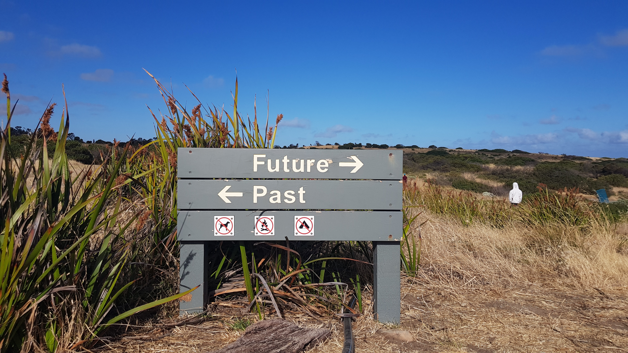
What’s Next?

Slide 68
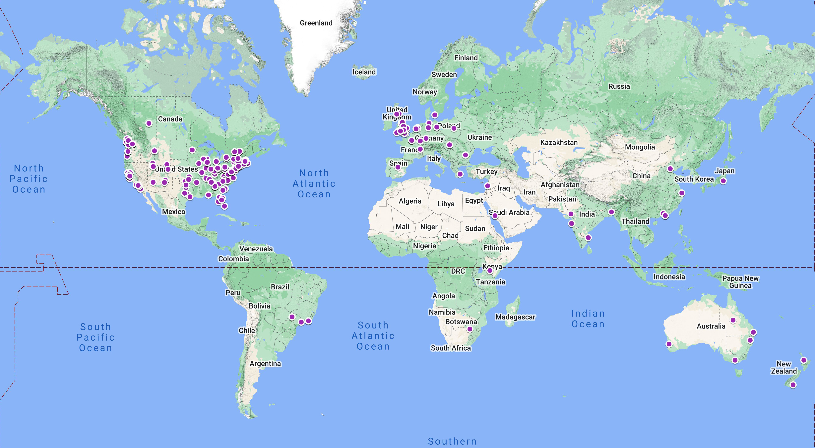
Global Reach

Slide 69

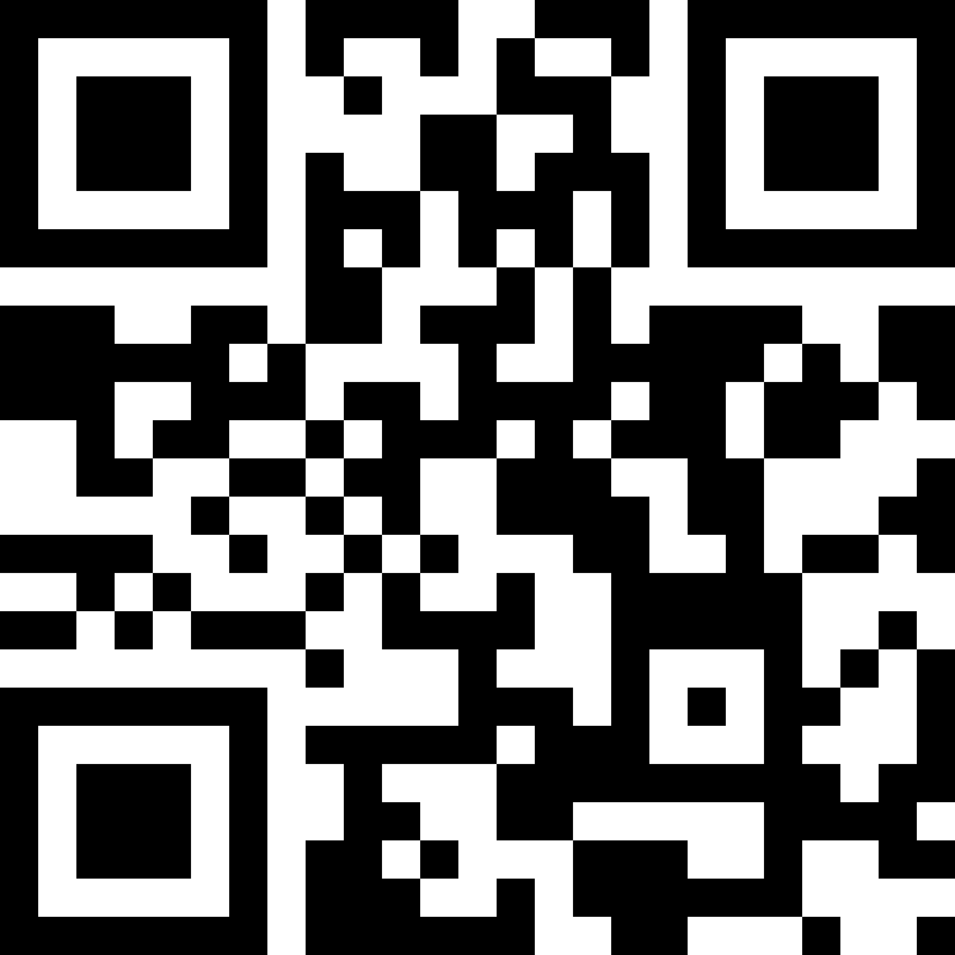
http://niso.plus
Notes:
We have one keynote speaker: We are delighted to announce that Professor Virginia (Ginny) Barbour, Editor-in-Chief of the Medical Journal of Australia and Adjunct Professor at Queensland University of Technology (QUT), will deliver one of two keynote addresses at the NISO Plus 2024 Global/Online conference.
Session proposals regarding Metadata standards for research integrity, open scholarship, Research Data Framework, author identity and name changes, research infrastructure, emerging technology, and more.

Slide 70

February 2025
Notes:
Mention Humanties roundtable preconference

Slide 71

http://niso.plus

Slide 72
Financial Report

Slide 73
Membership Trends 1998-2022
Notes:
Here we see the spike in membership within NISO driven by our strategy to approach and work with consortia.

Slide 74
Notes:
NISO revenues were up significantly by 14.5% in 2023 compared with 2022 continuing a trend since the late 20-teens. Total revenue (pre-audit) totaled $1,493,463. Member revenue, which is by far the largest share of our income, increased modestly by 3.6% up significantly they ear before. Events Revenue dropped by about 29% driven by decrease in online events income and decreases in sponsorship income in 2023. This was made up for by a nearly doubling of grant income in 203 as work related to the CCLP project and income for that grant from IMLS ramped up. This will continue to support NISO’s work through 2025. In addition, the Sloan grant for our work on retractions also pick up significantly in 2023 and is drawing to a close in 2024.

Slide 75
NOTE: 2023 Breakdown of expenses isn’t yet available
Notes:
Total Expenses in 2023 were approximately $ 1,481,377, which is up 8.6% from 2022. In large part this was due to significant increase in expenditures because of the IMLS Grant received late in 2022, along with a grant from the Sloan Foundation to do work on retractions. We have also increased investments in staffing to be more aggressive with supporint our work, which is adding to costs overall. We also returned to in-person events for NISO Plus, in 2023 with the Forum, which are significantly more expensive than pre-pandemic. We have begun the process of identifying a new audit firm so therefore, we don’t yet have our audit complete. As such, we don’t yet have the breakdown of our functional expenses by programmatic area.

Slide 76
Financial trends 1998-2023 (pre-audit)
Notes:
Preliminarily, it is looking like we will show a modest increase in our net assets in 2023.
We have been investing significantly in growth over the past several years, as has been seen in our membership, our programmatic and expenses. The Board is well-aware of the need to boost back up our reserves and in 2024 initiative a strategy to build back up our balance sheet. While we have cash reserves, these are precariously too low for an organization of our growing size. In 2024, the NISO Board has focused attention on boosting our reserves by setting aside funds toward our reserves at the beginning of the year with a goal of increasing our reserves by at least $125K in the next three years.

Slide 77
Looking Forward

Slide 78
Welcome New NISO Directors (2024-27)
Jonathan Clark, Principal, Independent Consultant and Managing Agent DOI Foundation
elected Vice Chair of the NISO Board.
Trevor A. Dawes, Vice Provost for Libraries and Museums and May Morris University Librarian, University of Delaware (re-elected)
Jenny Mathias, Global Marketing and Operations Director, Cambridge University Press and Assessment
Jill Morris, Executive Director, PALCI, the Partnership for Academic Library Collaboration and Innovation
Emily Singley, Vice President, North American Library Relations, Elsevier

Slide 79
Strategies for Growth
Focus on integration of DEIA throughout our work
Continue to build NISO’s membership & engagement
  Engaging new market segments for Voting Membership
  Expanding our work into Cultural Heritage Conservation and other areas
  Engaging internationally
  Engaging with more libraries directly through consortial partnerships
Focus on building up NISO’s financial reserves after a period of investment
Explore ways to be more efficient in standards development work
Developing and extending partnerships with other organizations

Slide 80
Strategies for Growth
Continue to develop grant funding pipeline
  Exploring several new ideas for grant proposals (Implementation of CCLP work)
Extending NISO Plus Conference model by alternating in-person/virtual
  Returning to an in-person annual conference
  Continue NISO Plus Conference Series as virtual event in Fall 2024
  Build on model of discussion leading to ideas that develop into project and then solutions
Continued focus on value and adoption in the community of NISO work

Slide 81
Other interesting things on the horizon
NISO Training modules and learning arcs
Extending NISO Unfettered Access interview series
Integration of CARE principles for indigenous knowledge in the publication workflow in partnership with AGU
Efforts to improve the efficiency of SMART standards
New work ideas related to accessibility
US National persistent identifier strategy
Continued development and integration of NISO back-end systems
Continued development of NISO Plus Scholarship Program
Support of the Persistent Identifier (PID) community
Exploring Research Activity Id (RAiD) system development in the USA

Slide 82

To all those who engage in our work

Slide 83
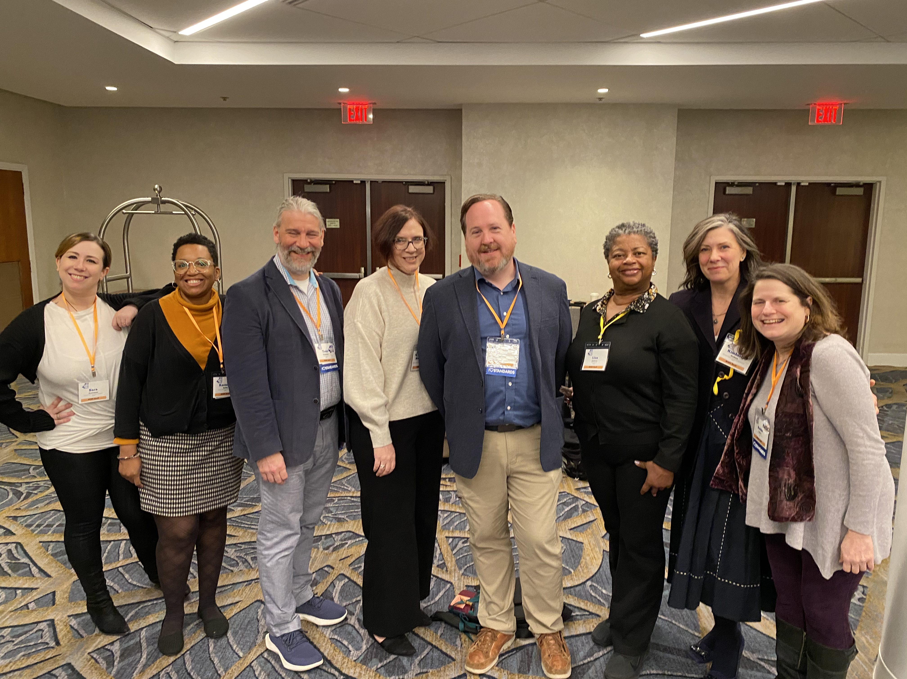
Thank you to the NISO Staff!

Slide 84
Please reach out!
Todd Carpenter
Executive Director
tcarpenter@niso.org
Nettie Lagace
Associate Executive Director
nlagace@niso.org
Keondra Bailey
Assistant Standards Program Manager
kbailey@niso.org
Mary Beth Barilla
Director of Business Development & Communications
mbarilla@niso.org
Kimberly Graham
Educational Programs Manager and
DEIA Advocate
kgraham@niso.org
Jason Griffey
Director of Strategic Initiatives
griffey@niso.org
Sara Groveman
Educational and Communications Coordinator
sgroveman@niso.org
Lisa Jackson
Office Manager
ljackson@niso.org
  3600 Clipper Mill Road
  Suite 302
  Baltimore, MD 21211 USA
  Tel.: (301) 654-2512
  www.niso.org
  @NISOinfo

Slide 85
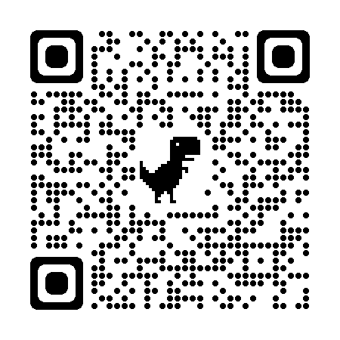
New to NISO?
Let us help!
Just click the QR Code to tell us
what types of NISO information
you want to receive:
NISO Announcements/Press Releases
NISO Information Organized (I/O)
Educational Programs
NISO Standards and Working Group Updates
NISO Plus
Or Visit: https://confirmsubscription.com/h/j/16B94AB10EFACDB2

Slide 86
Share your feedback
Our 2023 community survey closes tomorrow, June 30
  Tell us what you know about NISO and our work
  Share your thoughts on the challenges that lie ahead for our community
surveymonkey.com/r/AMM23

Slide 87
THANK YOU
Thank you to all of our attendees
for engaging with NISO and the community in our work and for joining us today!
Please stay in touch!

